Slide 1

Python Project
TITLE: Chess Game
Name: T Satyanarayana Reddy
Section: K23CH
Registration No: 12303112
Roll No: 48
Submitted To:
Aman Kumar

Slide 2

Introduction
What is Chess?
Chess is a strategic board game that involves two players competing on an 8x8 grid. The game emphasizes strategy, tactics, and skill.
Why Chess in Digital Form?
A digital chess game brings traditional chess to screens, enabling global accessibility, advanced features, and a more interactive experience.
Purpose of the Application
This game aims to provide an engaging platform for players to enjoy chess, learn strategies, and compete in an easy-to-access digital environment.

Slide 3
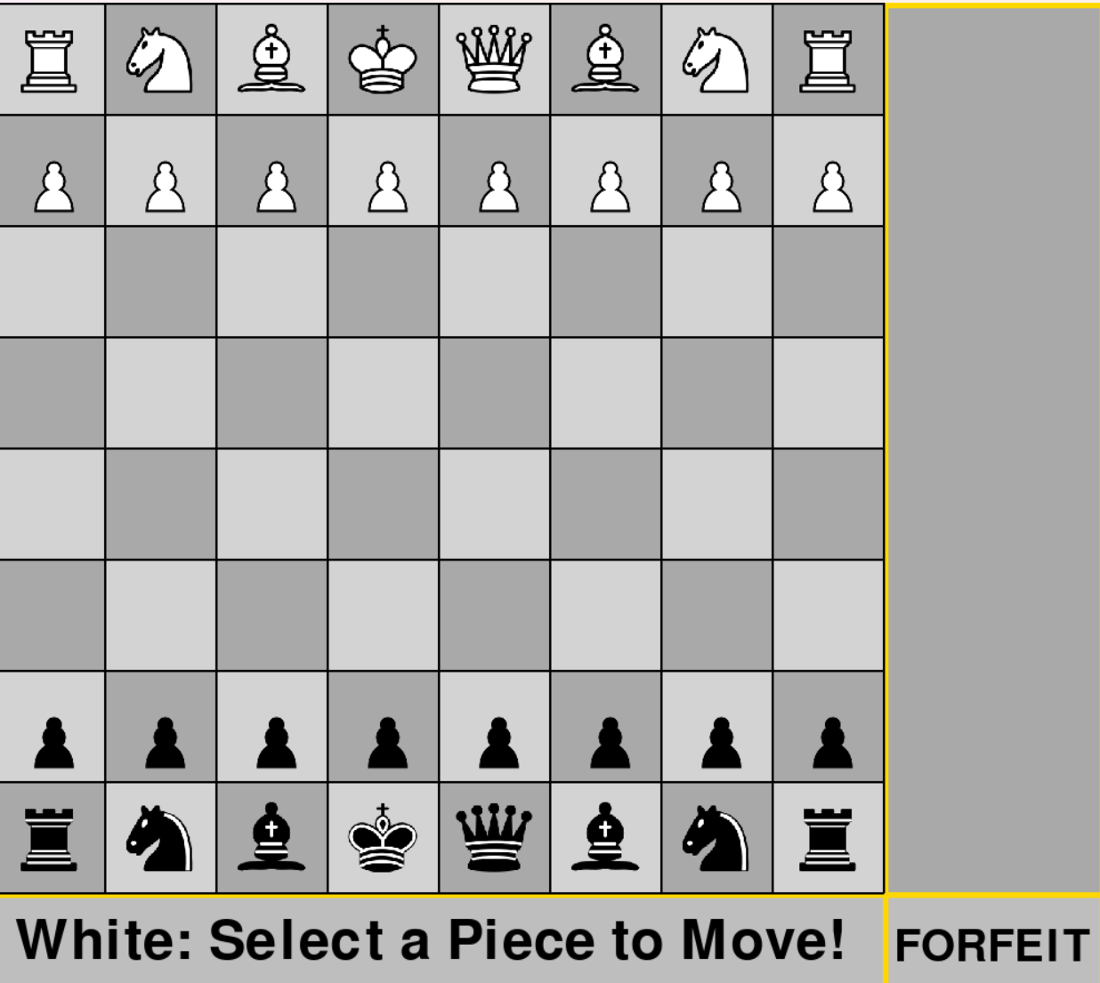
Key Features of the Chess Game
1
Realistic Board and Pieces
2
Turn-based Gameplay
3
Capturing and Move Validation
4
Player Turn Indication
5
Winning Conditions and Restart

Slide 4
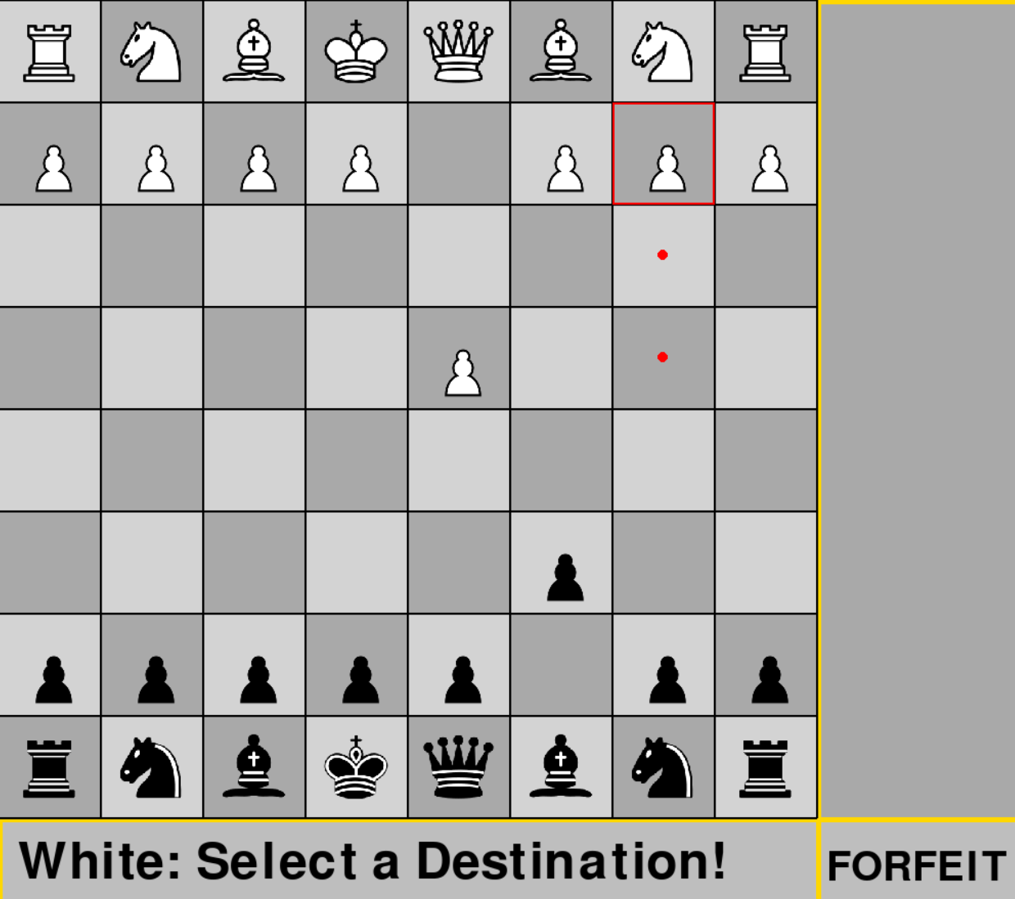
Functionalities
Interactive Gameplay
The chess game provides an interactive platform with realistic piece movement and an engaging interface.
Rule Enforcement
Ensures compliance with chess rules such as valid moves, turn-based system, and checkmate detection.
Player Feedback
Displays move hints, captures, and win conditions to enhance the player experience.

Slide 5
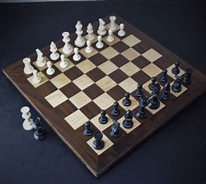
Future Scope
Online Multiplayer
Integrating online multiplayer mode to allow global competition and connection.
AI Opponent
Adding AI-driven opponents with varying difficulty levels to enhance solo gameplay.
Advanced Analytics
Incorporating game analytics and learning tools for strategy improvement.

Slide 6
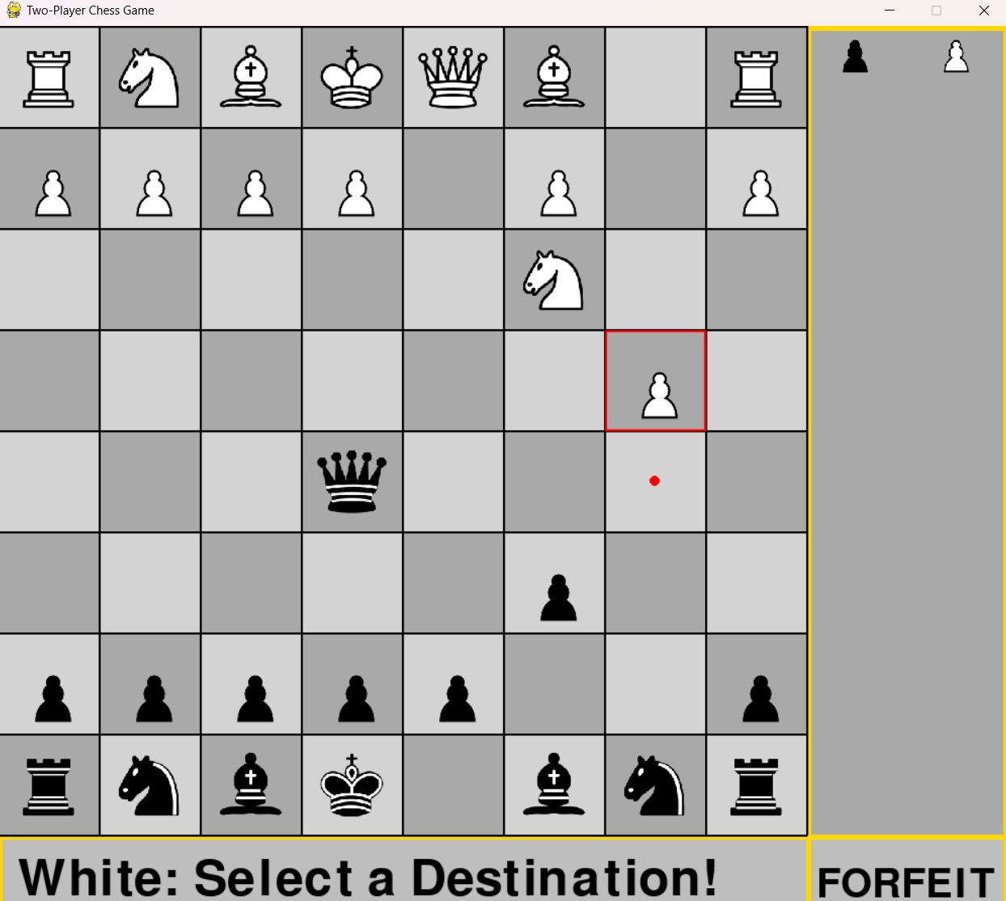
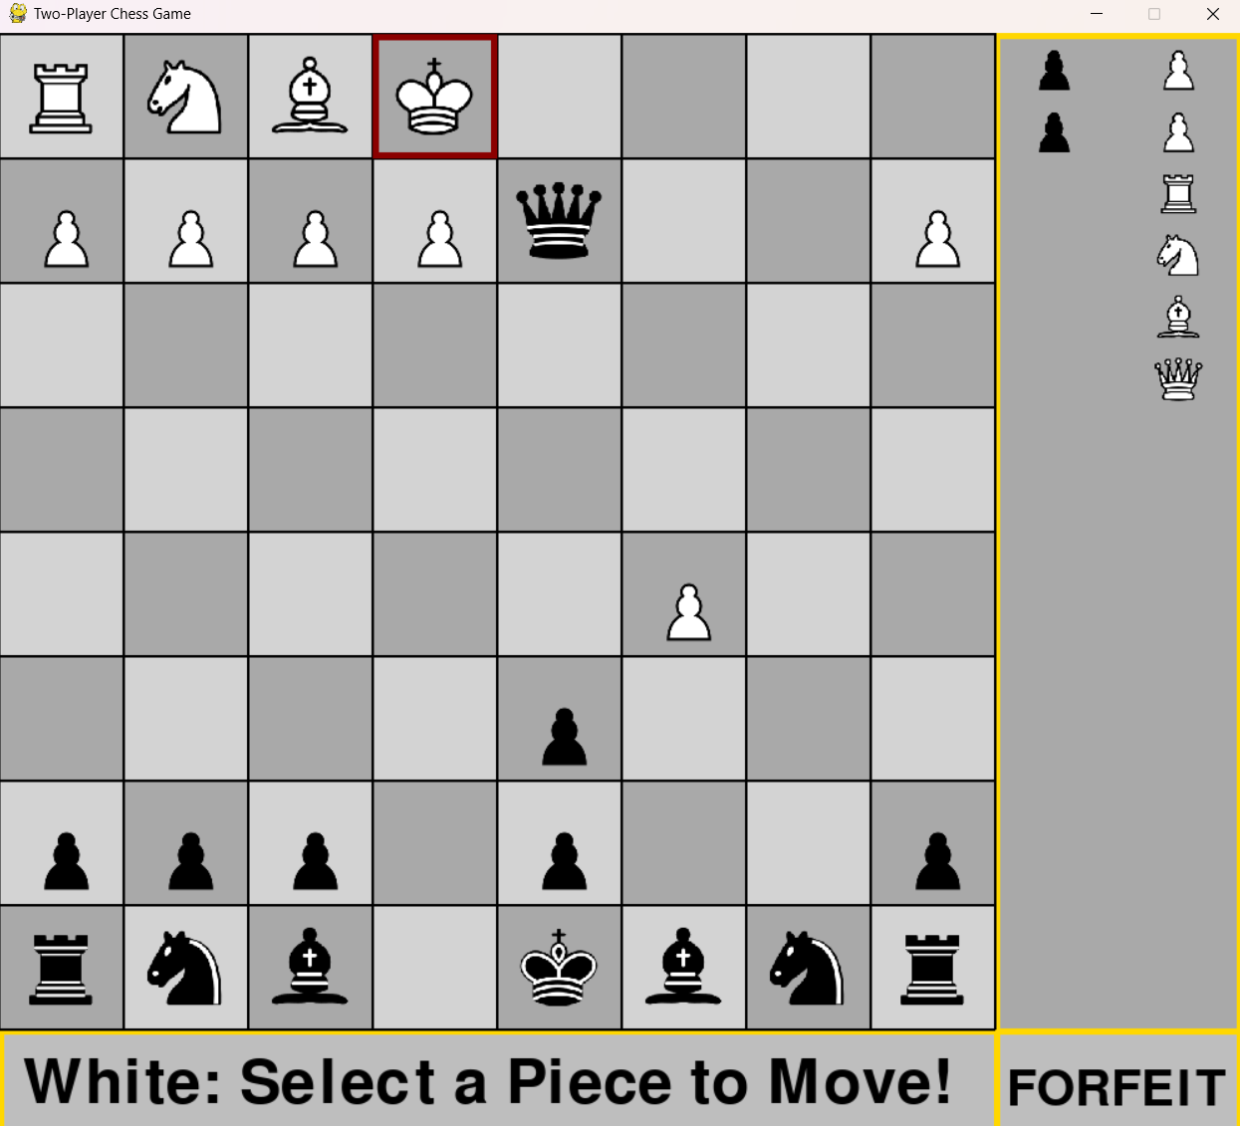
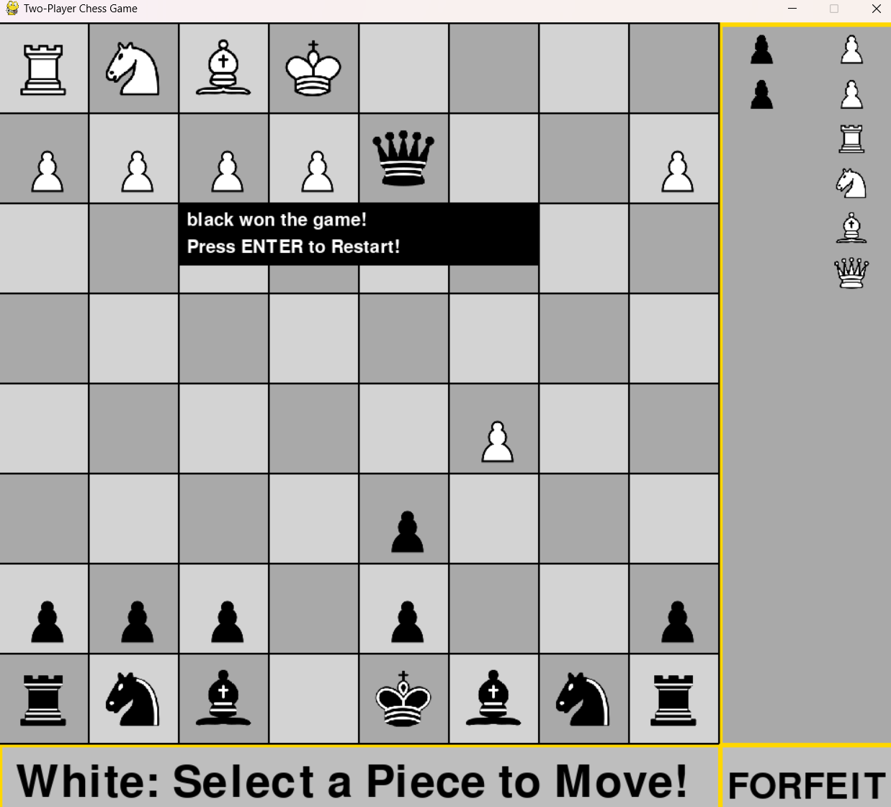
Game Interface

Slide 7
What’s next for this chess game?
The digital chess game opens a world of strategic entertainment, providing a blend of tradition and modern technology. Let’s explore the potential together!
Conclusion

